Slide 1
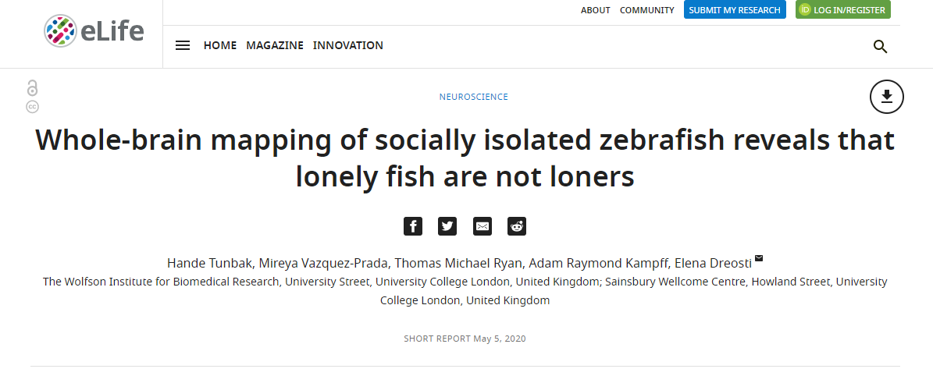
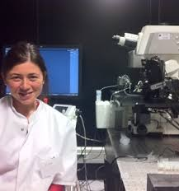
Neuroscience of social behaviour: in-depth seminar
Dr Will Norton: whjn1@le.ac.uk

Slide 2
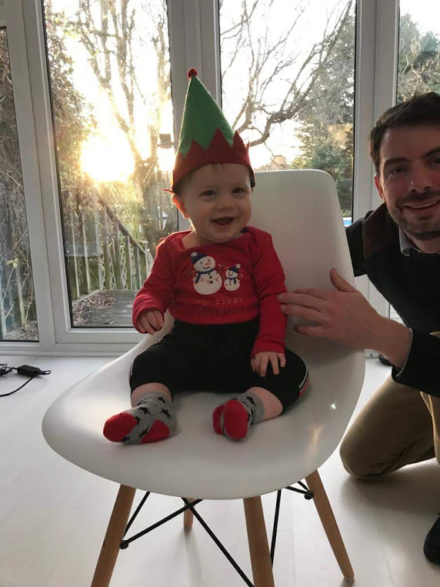
Animals display social behaviour from birth onwards
A small subset of a population of animals are asocial (“loners”)
Disruptions to social development can lead to autism and other
psychiatric disorders
Difficult to study the circuits that control social behaviour
in humans - develop in utero
Other animal species display social behaviours – including
zebrafish, model for vertebrate behaviour and development
Santa’s little helper

Slide 3
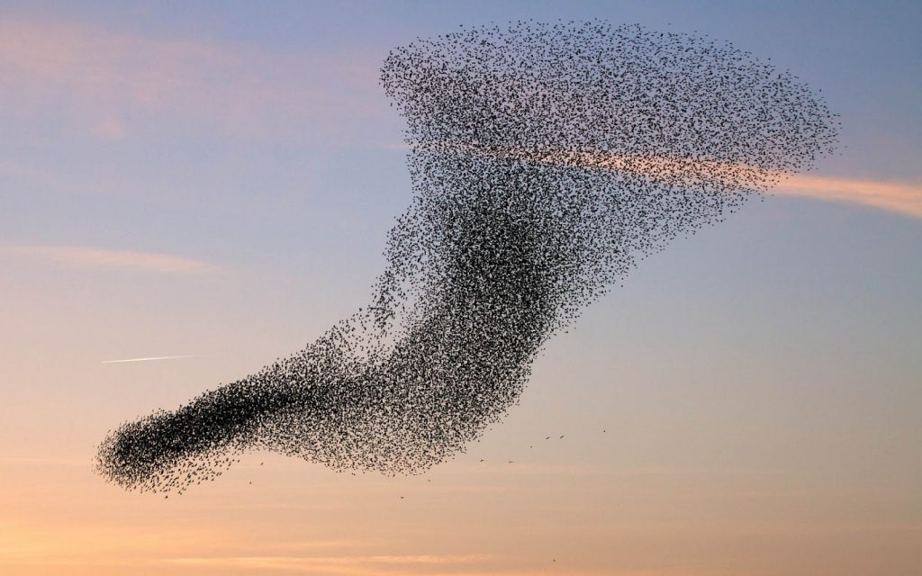
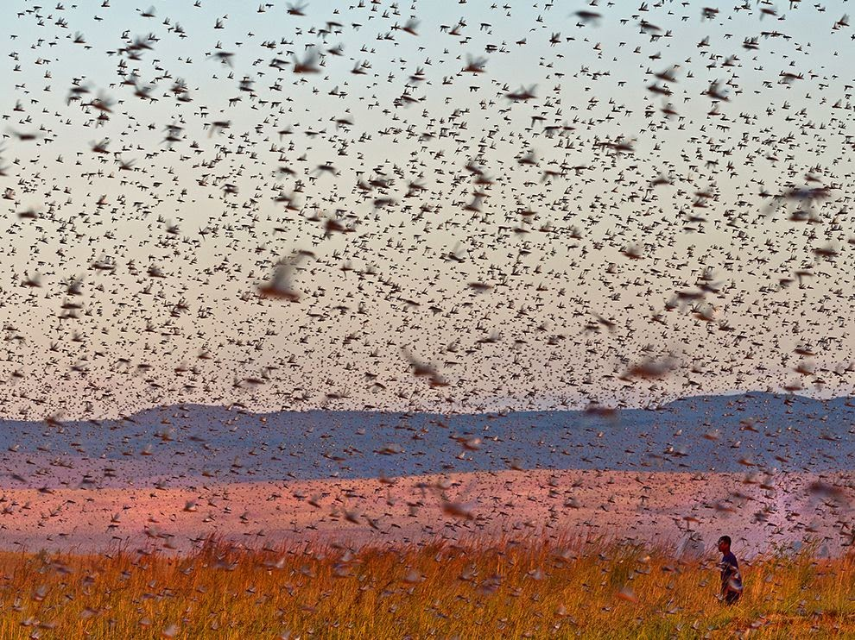
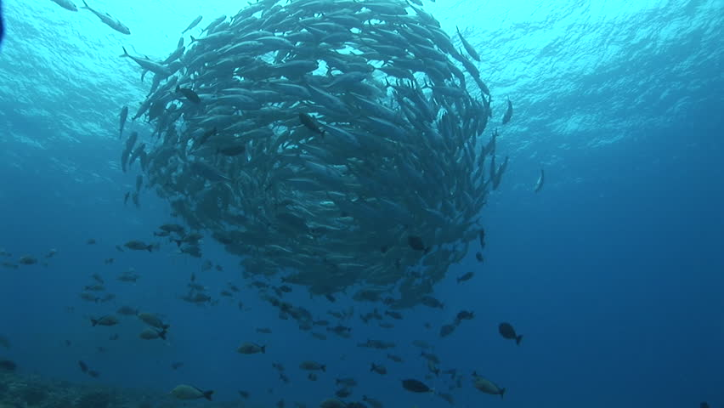

Social behaviour

Slide 4
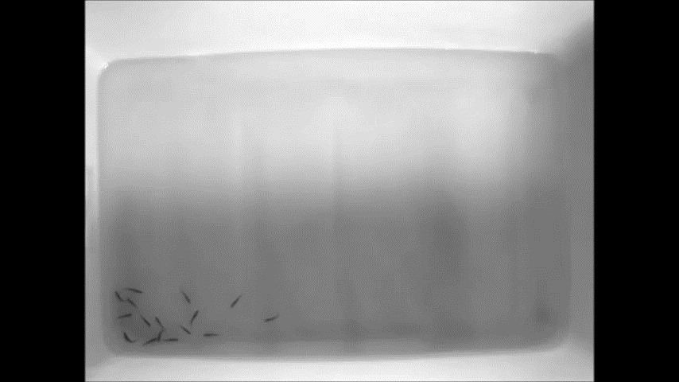
Shoaling – social interactions in a group

Slide 5
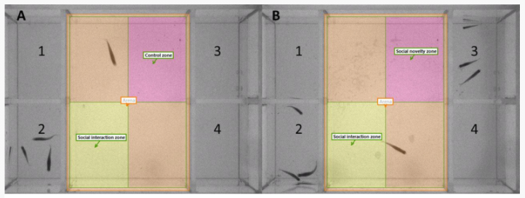
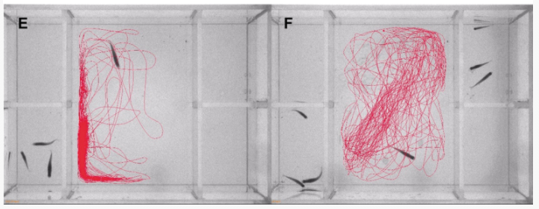
Visually-mediated social preference test
From Reichmann et al., 2020

Slide 6
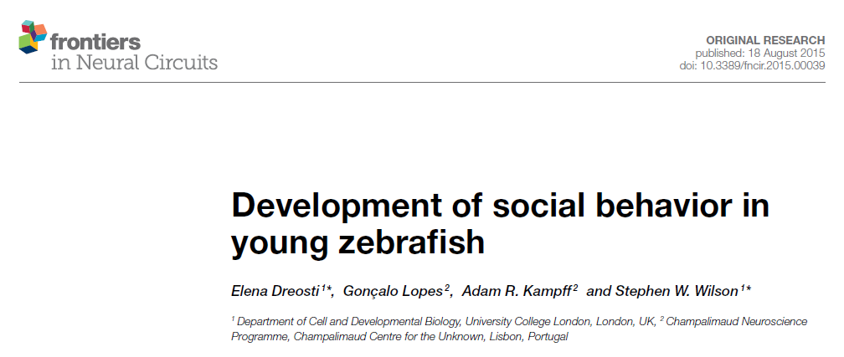
Background information

Slide 7
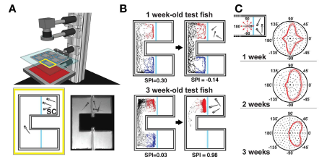
Figure 1 from Dreosti et al., 2015
B: Development of preference for conspecifics over time
C: Orientation of eye (L/R) towards stimulus over time
Dreosti et al., 2015

Slide 8
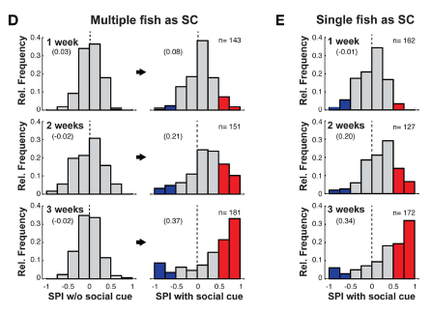
Figure 2 from Dreosti et al., 2015
Frequency of social preference (index) over time
A subset of fish (10%) are antisocial
Dreosti et al., 2015

Slide 9
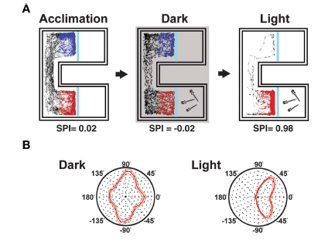
Social behaviour is visually-based
Figure 2 from Dreosti et al., 2015
Dreosti et al., 2015

Slide 10
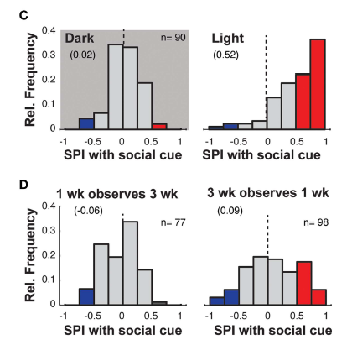
Figure 2 from Dreosti et al., 2015
Three week old fish interact with younger animals
One week old fish do not display sociality
Dreosti et al., 2015

Slide 11
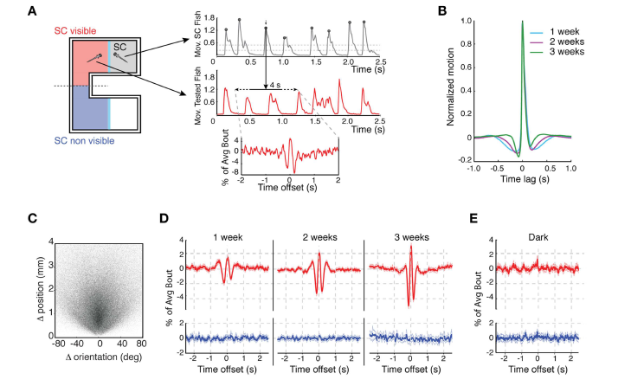
Figure 3 from Dreosti et al., 2015
Red = with fish
Blue = no fish
Larvae move in response to movement of the stimulus fish – locked together in time
Each individual bout has a characteristic shape; mixture of forward swims and turns

Slide 12
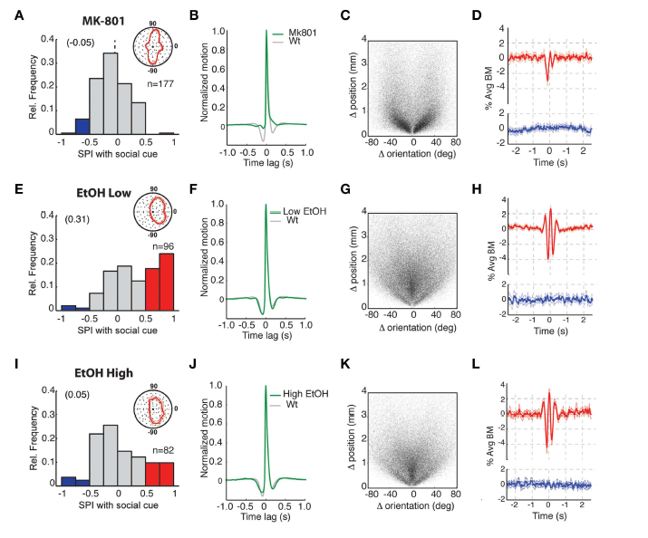
Figure 4 from Dreosti et al., 2015
Movement becomes
uncoupled!
MK-801 (NMDA antagonist) and EtOH disrupt social behaviour;
similar neurotransmitter basis as seen in other species
Dreosti et al., 2015

Slide 13
Background summary
Zebrafish display social preference from 3 weeks onwards. Parallels development of critical
forebrain structures (pallium; Dirian et al., 2014)
Driven by visual cues; larval movement is locked to the movement of the stimulus
MK-801 and ethanol had a different effect on social behaviour. Both drugs reduced social
interaction, but MK-801 decreased coupling of movement as well
This setup can be modified to image the whole brain when playing a film of a social stimulus
What is the impact of isolation (short / long term) on social behaviour?
Dreosti et al., 2015

Slide 14
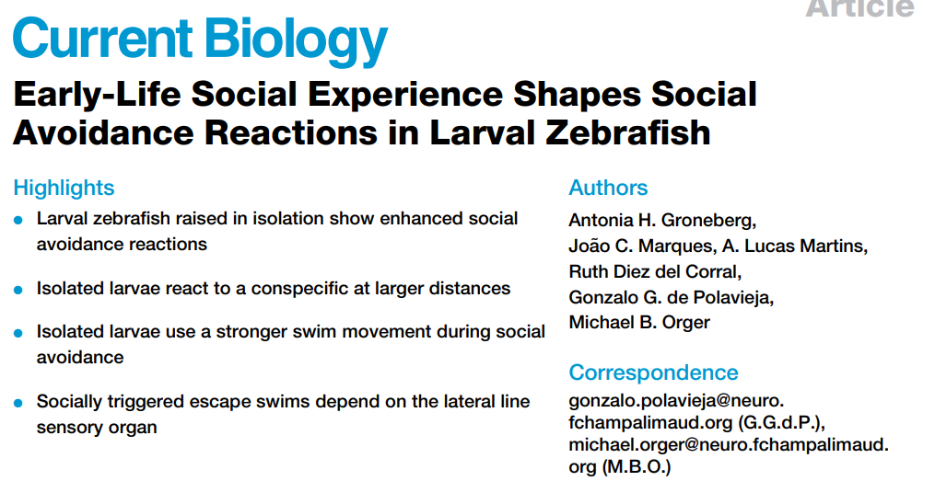

Slide 15
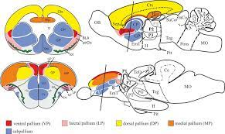

Social avoidance and interaction are distinct processes
Social interactions first develop at about 3 weeks of age (linked to subpallium development?) –Dreosti paper
Social avoidance develops earlier on – at about one week
Compared fish isolated from 0 days to 7 days with fish grown in groups of 7 animals
Isolated animals tend to swim slower and in longer bouts (stop less often)

Slide 16
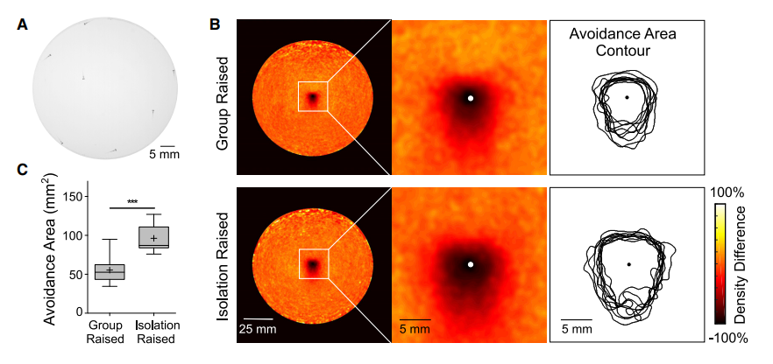
Compare avoidance in group- and isolation raised fish
Recorded groups of 7 fish in a round tank
Isolated fish maintain greater distance away compared to group-raised fish

Slide 17
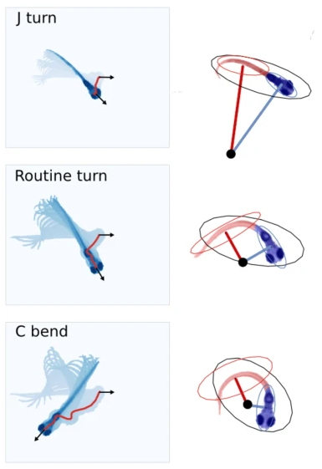
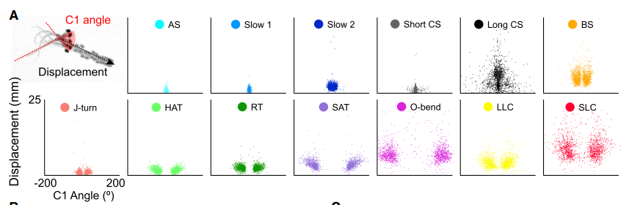
Larval fish display different types of movements
Machine learning to categorise types of swim:
Forward displacing bout types: slow1, slow2, the short capture swim (short CS), approach swim (AS)
Reorienting bout types:, such as the J-turn, high angle turn (HAT), and routine turn (RT)
Six bout types that displace the larva one body length and have variable C1 angles: long capture swim (long CS),
burst swim (BS), the shadow avoidance turn (SAT), the O-bend, and the long-and short-latency C-start (LLC / SLC)

Slide 18
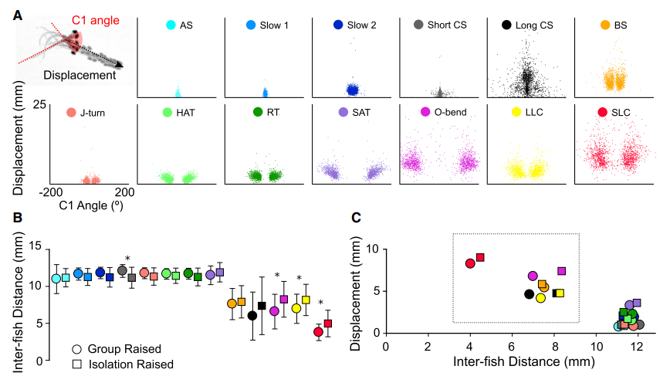
Isolated fish perform large displacement swims (e.g. SLC/LLC) at greater distances
Compared to GR. This helps them to maintain greater distance from conspecifics
Short CS, O-bend, LLC, SLC

Slide 19
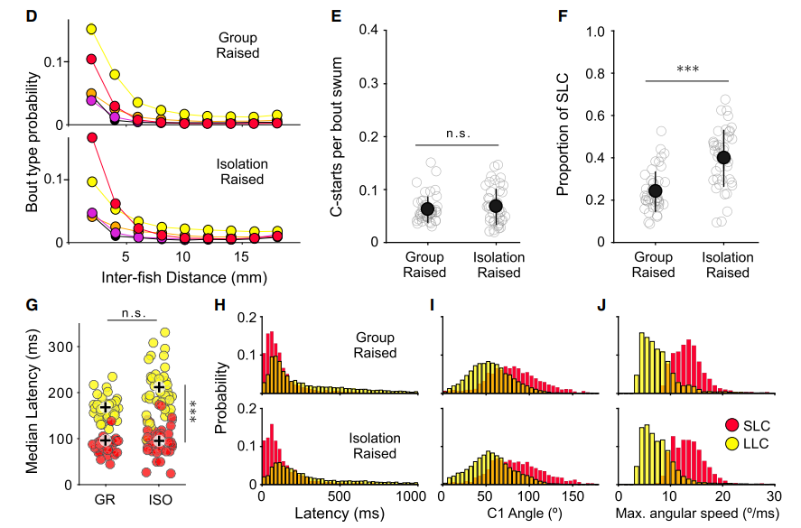
LLC
SLC
Isolated fish more likely to perform SLC compared to LLC
No difference in latency, C1 angle or max. angular speed

Slide 20
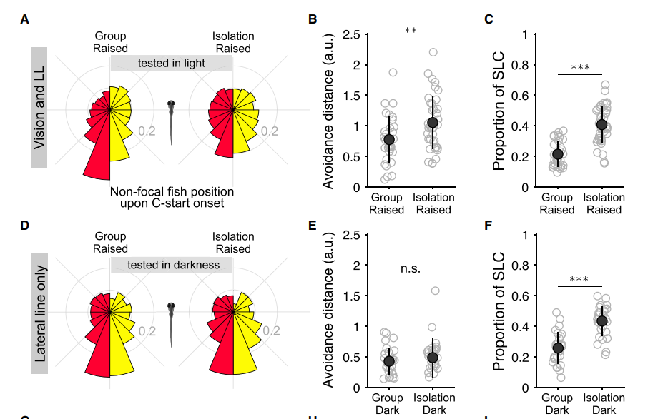
What stimuli drive the C-starts?
Angle of non-focal
fish (stimulus)
Bias towards stimulation at tail end of animal
Vision is not needed

Slide 21
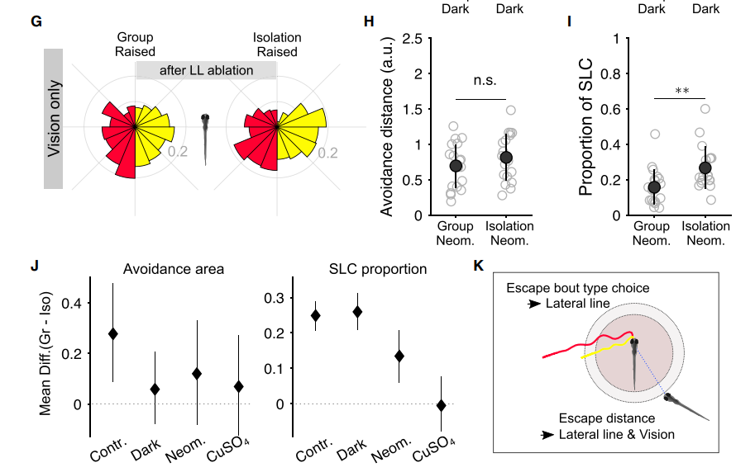
Lateral line important for response
Smaller diff
here

Slide 22
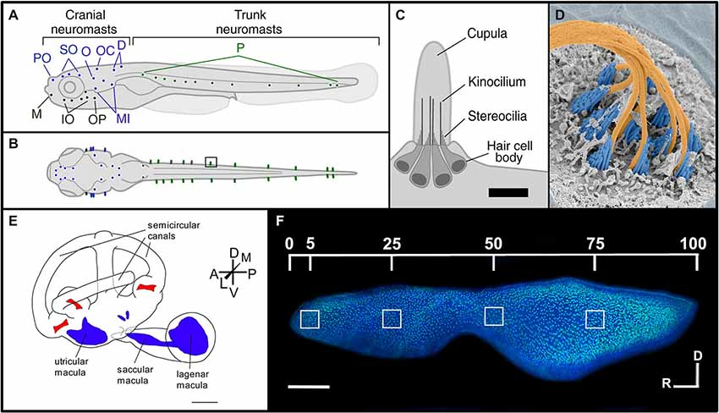
The lateral line system
Senses water movement – important for behaviour?
Octavolateral nerve = vestibulocochlear

Slide 23
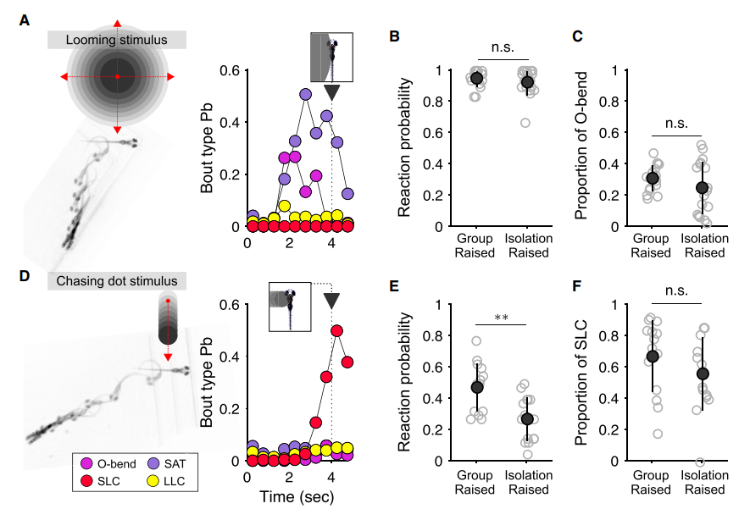
What stimuli triggers the choice of SLC and LLC in larvae?

Slide 24
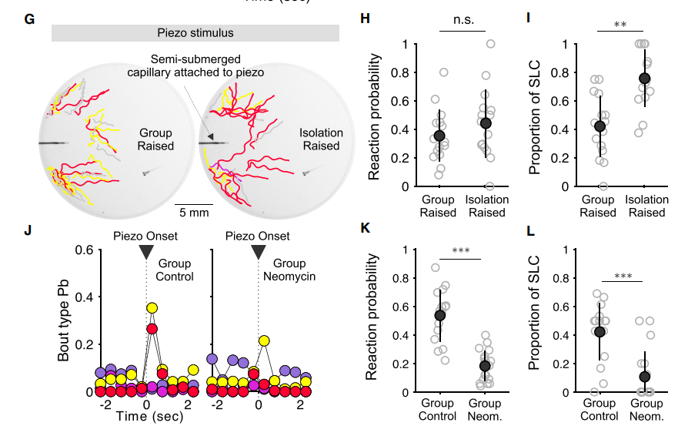
Stimulating the lateral line biases towards short latency C-starts
Control
Ablating the lateral line severely decreases the probability of startle

Slide 25
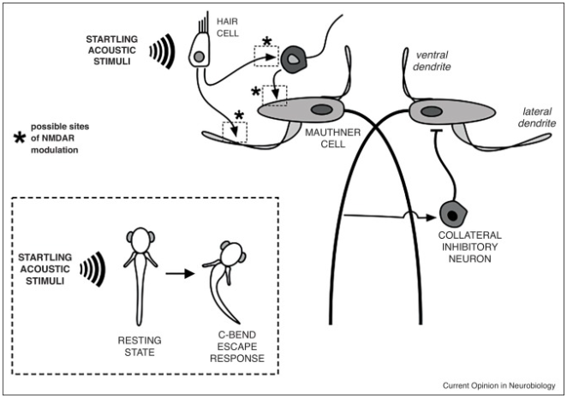
How is the change between SLC and LLC controlled by the brain?
Could be linked to the Mauthner neuron – change in excitatory/ inhibitory inputs?

Slide 26
How is the change between SLC and LLC controlled by the brain?
Different sensitivity of lateral line to vibration?
- Test by raising larvae water with different vibration regimes

Slide 27
Conclusion
Isolation increases the number of short latency (quick) C-starts compared to long-latency C starts:
Isolated fish react more quickly to conspecifics, and use a large-displacement movement to keep away
from other fish
Choice of type of response is not visual – driven by the lateral line system
Vision is needed to generally set distance between animals (across species)
The effect is separable from the general locomotion change seen in isolated animals

Slide 28

Questions?
How convinced are you by this data?
What experiments would you do next?
Which other neurotransmitter could be important for this phenotype
What are the implications for other species?

